Slide 1

Imputation strategies for risk prediction models based on Electronic Health Records
Lee Lok hang Toby 2431180L
Notes:
Hello, welcome to the presentation for my level 4 honours individual project. My research topic is to develop different Imputation strategies for risk prediction models based on Electronic Health Records
This research focuses on how to use imputation strategies to improve risk prediction models for clinical decision support systems. As summarising and pre-processing electronic health records is not trivial, this research guides the user through extraction and pre-processing pipeline for patients and events data from the MIMIC-III database. Different imputation strategies will then be applied to the pre-processed clinical data, where the effectiveness of these strategies is analysed through evaluating the accuracy of the risk prediction model created. To further evaluate these imputation strategies, multiple statistical analysis is carried out including various descriptive visualisations and data sample holdout simulations.

Slide 2
Overview
Introduction and Background
Motivation and Aims
Methodology
Results and Evaluation
Conclusion
Notes:
Lets begin with an overview of this presentation.
This presentation will be separated in the following sections including:
Some important background information to understand my research
The Motivation and Aims of this project
The Methodology I used to solve my research question
The Results and Evaluation of my research
And finally a Conclusion of my research

Slide 3

Introduction and Background
What is an Electronic Health record?
Risk Prediction models with Electronic Health Records
Missingness in Electronic Health records
Missing Completely at Random
Missing at Random
Missing not at Random
Notes:
Electronic Health records (EHR) is a systemized digital collection of patient's information. Compared to traditional health records, Electronic Health records allow accurate and up to date information about patients that could be quickly accessible by different clinics, allowing a more coordinated healthcare system. The advances in technology also allow more secure and efficent storing of these records while saving costs. Lastly, since the records are now digital, it can contain a more detailed medical history, including diagnoses, medications, treatment plans, allergies, radiology images, and laboratory test results.
A risk prediction model uses patient data to estimate the probability of a patient experiencing a healthcare outcome. With the recent releases of publicly available clinical database, and advancement of machine learning in recent years , more accurate and reliable risk prediction models are now possible.
However, since electronic health records are heterogeneous with all sorts of medical recordings, these recordings must be extracted carefully and reorganised for machine learning. By arranging the medical data by rows of time series, the machine learning model is able to learn complex temporal patterns from the data and improve performance. However, by organizing these medical recordings in a time series manner, in introduces a lot of missing data since there could not be a record of every variable for every hour. In a machine learning environment, values that are missing not at random introduces a lot of complexity since these missing values could carry hidden meaning that could be provide useful information. If these missing value is simply removed or ignored, it would introduce bias since we are ignoring information provided to us. This is another reason why more complex imputation strategies is used to try and preserve these meanings and reduce bias in our training environment.
There are 3 different types of missing data,
Missing completely at random implies that the causes of missing data are completely unrelated to the data. An example of MCAR could be because of sudden power shortage in the hospital, which result in lost of recordings.
Missing at random implies that the cause of the missing data is somewhat related to the data, but not directly. AAn example of MAR would could be because the patient had surgery that day, therefore would not take the daily blood sample tests. Different from MCAR, MAR is a broader class and often more realistic.
Missing not at random is when the probability of missing values varies for reasons that are unknown. An example of MNAR would be because the patient simply does not require this laboratory test for his symptoms, therefore was left empty.

Slide 4
Motivation and Aims
Explore the MIMIC-III dataset and form appropriate queries to extract medical variables based on specific exclusion/inclusion criteria.
Pre-process the medical variables to convert units, remove outliers and reorganise the data into time series data
Use different imputation strategies to impute missing values found in the time series data
Create Risk prediction models using different imputation strategy
Evaluate the performance of risk prediction models with different imputation strategies.
Notes:
This research focuses on how to use imputation strategies to improve risk prediction models for clinical decision support systems. As summarising and pre-processing electronic health records is not trivial, this research guides the reader through extraction and pre-processing pipeline for patients and events data from the MIMIC-III database. Different imputation strategies will then be applied to the pre-processed clinical data, where the effectiveness of these strategies is analysed through evaluating the accuracy of the risk prediction model created. To further evaluate these imputation strategies, multiple statistical analysis is carried out including various descriptive visualisations and data sample holdout simulations.

Slide 5
mETHODOLOGY
Extraction Pipeline
Pre-processing Pipeline
Imputation Strategies
Notes:
Machine learning is a type of artificial intelligence that can be used to learn patterns from data and make predictions. It can also be used to create risk prediction models that could help in managing medical resources and improving healthcare services. However applications in clinical-decision support system is found to be very limited due to the challenges in summarizing and representing patient data, along side privacy concerns and ethical issues of using real patients data. However, due to the digitisation of health records, large amount of healthcare data are easily accessible digitally, which introduces the possibility to share these records with researchers around the world for scientific purposes.
Since electronic health records consists of private information including name, gender, date of birth, and other sensitive identification information, these electronic health records are often not publicly available. It is until recently, a large, publicly available, and deidentified clinical database named MIMIC-III is released, which allow researchers from different fields to get their hands on large amount detailed and organised clinical data. Despite the introduction to new data, one of the biggest problem of missing data in electronic health records still remains. Most clinical data are time series data with different measurements taken at different times, meaning there will be missing measurements in some time frame for each patient. These missing data are often not missing at random, meaning there is a meaning and reason to why this data is missing, which further complicates the problem. Missing data limits our ability to train the risk prediction model and reduces the statistical power of our model. To solve this problem, imputation strategies is applied to impute these missing data, and different approaches to this problem could greatly affect the performances of these risk decision models.

Slide 6


Extraction Pipeline
Length of stay
MIMIC-III
Extract Patients data
In-Hospital Mortality
Cohort Selection
Mapping to Variables
Pre-processing
1< Days <10
Age>15
16 baseline Variables
Notes:
Patients data is extracted from the MIMIC-iii database using cohort selection of patients that is aged over 15 and stayed between 1 and 10 days within the hospital. The Length of stay and in-hospital mortality is also extracted from patients data as clinical outcomes for the risk prediction models. The extracted events data is then mapped to patients data and medical variables for the preprocessing stage.

Slide 7
Pre-processing pipeline
Extraction Pipeline
Unit conversions
Removing outliers
Data Representation
Imputation
Notes:
Different units for the same medical variable is prevented by applying unit conversion techniques to the extracted data. Outliers out side of variables will also be replaced my null values for imputation later. Lastly the data is reshaped from one medical recording per row into time series data that contains all variables in every row. The pre-processed data is used to apply different imputation strategies.

Slide 8
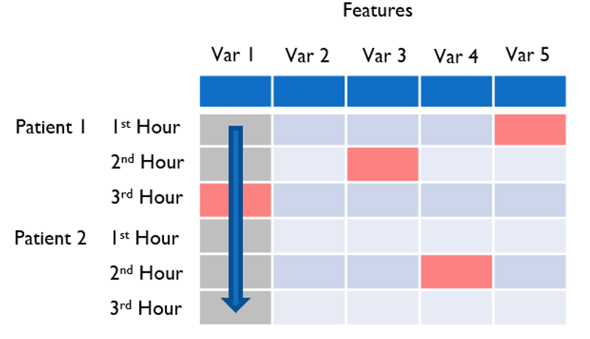
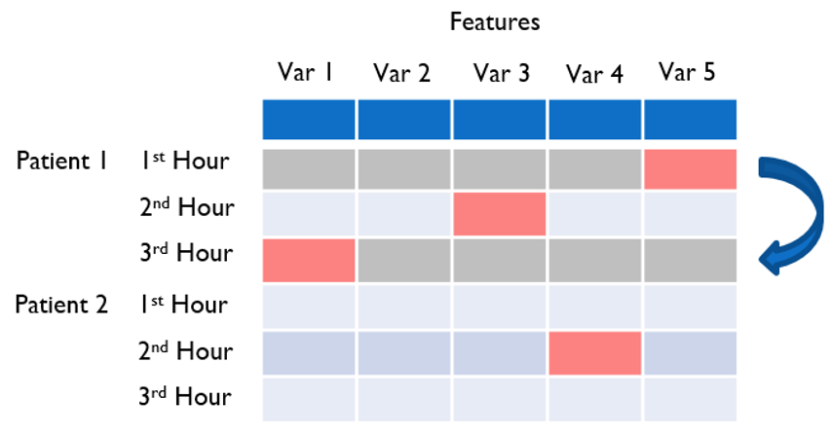
Univariate VS multiVariate
Uni-variate
Multi-variate
Notes:
Before moving on to the different imputation strategies individually, we must first talk about the two types of imputation.
The first type of imputation strategy is univariate, where the missing values is imputed only by non-missing values within the same feature, highlighted in gray vertically in the diagram on the left.
The second type of imputation strategy is multivariate, instead of only considering values from the same feature, these strategy consider the data in multiple dimensions across all features and uses the full set of data to estimate the missing values.

Slide 9
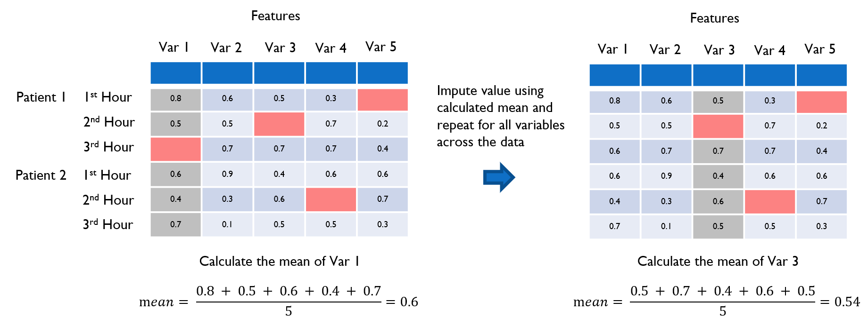
Mean imputation
Notes:
Mean imputation fills in missing values simply by using the mean of all non missing variable in each column. Although mean imputation is easy to implement, it does not work well with categorical feature and often introduce bias to the dataset.

Slide 10
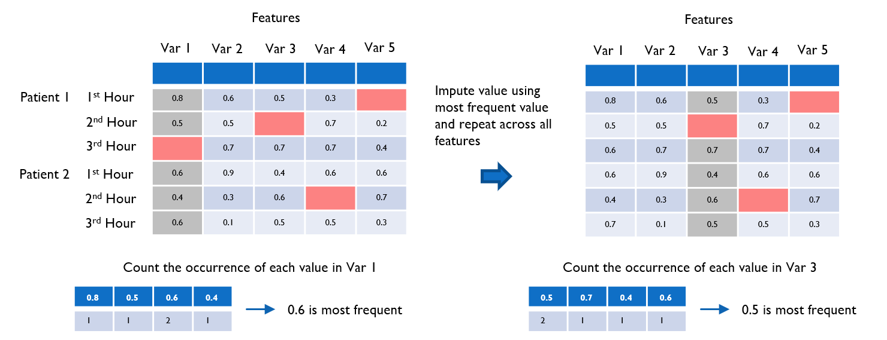
Most Frequent imputation
Notes:
Instead of taking the mean of all non missing values, most frequent imputation counts the occourence of all values and replace the missing values with the most frequent value within each column. Similar to mean imputation, although it is easy to implement, it often introduces bias to the data.

Slide 11
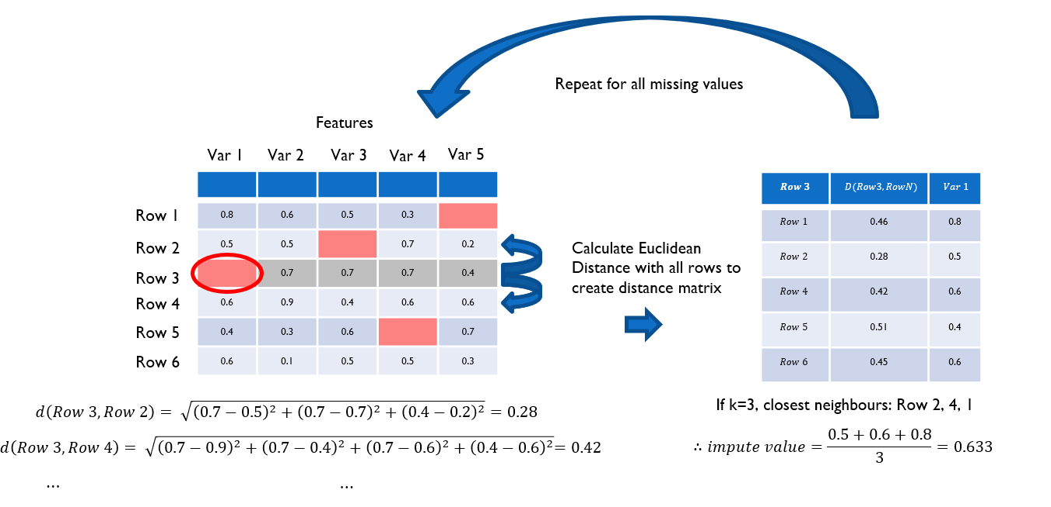

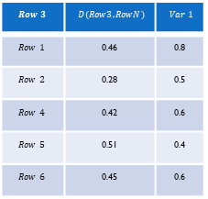
KNN impuation
Repeat for all missing values
Features
Var 1
Var 2
Var 3
Var 4
Var 5
0.8 | 0.6 | 0.5 | 0.3
0.5 | 0.5 |  | 0.7 | 0.2
 | 0.7 | 0.7 | 0.7 | 0.4
0.6 | 0.9 | 0.4 | 0.6 | 0.6
0.4 | 0.3 | 0.6 |  | 0.7
0.6 | 0.1 | 0.5 | 0.5 | 0.3
$$Row 3$$ | $$D(Row3, RowN)$$ | $$Var 1$$
$$Row 1$$ | 0.46 | 0.8
$$Row 2$$ | 0.28 | 0.5
$$Row 4$$ | 0.42 | 0.6
$$Row 5$$ | 0.51 | 0.4
$$Row 6$$ | 0.45 | 0.6
Row 1
Row 2
Calculate Euclidean Distance with all rows to create distance matrix
Row 3
Row 4
Row 5
Row 6
$$d\left(Row 3,Row 2\right)= \sqrt{{\left(0.7−0.5\right)}^{2}+{\left(0.7−0.7\right)}^{2}+{\left(0.4−0.2\right)}^{2}}=0.28$$
If k=3, closest neighbours: Row 2, 4, 1
$$d\left(Row 3,Row 4\right)= \sqrt{{\left(0.7−0.9\right)}^{2}+{\left(0.7−0.4\right)}^{2}+{\left(0.7−0.6\right)}^{2}{+ \left(0.4−0.6\right)}^{2}}=0.42$$
$$∴impute value=\frac{0.5+0.6+0.8}{3}=0.633$$
$$⋯$$
$$⋯$$
Notes:
K-Nearest-Neighbor (KNN) imputation is our first multivariate imputation that utilizes a distance based representation of all data. The KNN algorithm calculates the Euclidean distance between all row combinations to locate its K nearest neighbors for each missing value. The mean value from the same column of these neighbors is then used as the imputation value. This is then repeated across the entire dataset for all missing values.

Slide 12
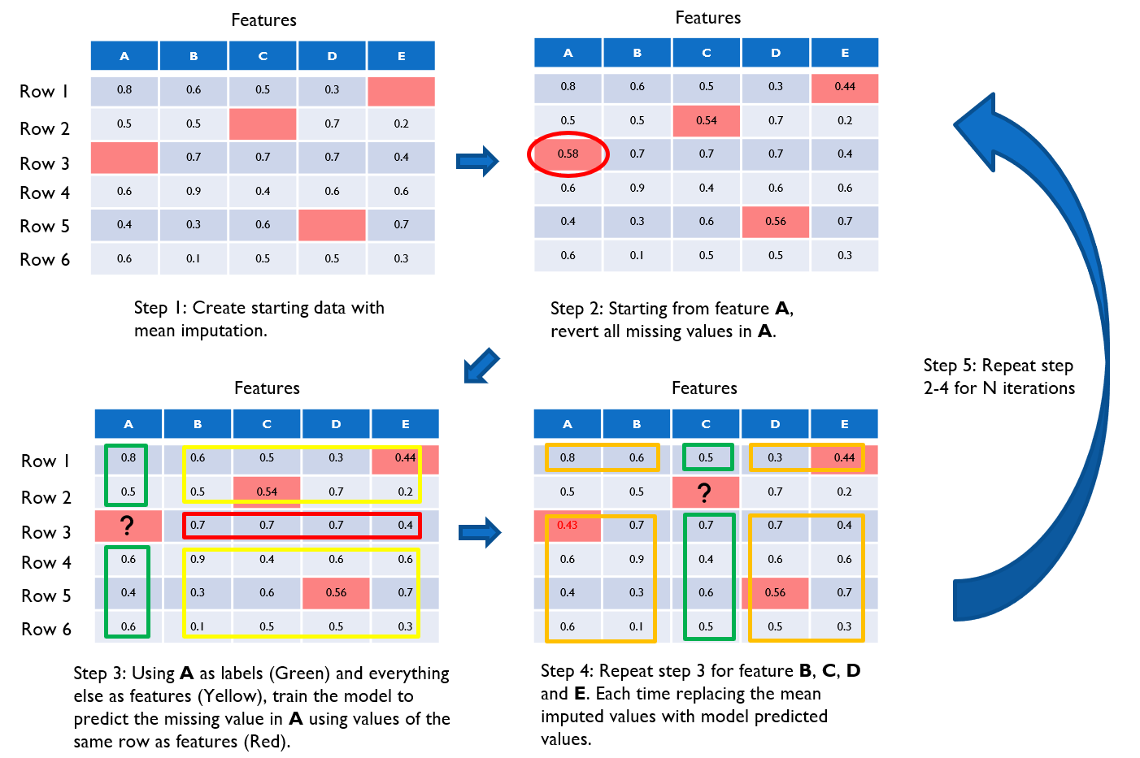
Multiple imputation with chained equation (MICE)
Notes:
Multiple imputation by chained equations (MICE) is a multivariate imputation strategy that imputes missing data through an iterative series of predictive models. Creating multiple imputations rather than single imputation takes considerations into the statistical instability and uncertainty in the imputations, while being flexible with both numerical and categorical variables.
The MICE algorithm often start by using mean imputation or random predictions to fill up all the missing data, since we could not apply the predictive model if there are missing values in the data. For each iteration, the algorithm starts by selecting a feature and reverting it's missing values to null, which will later be filled by the predictive model we train. To obtain the train data for the model, the non missing values in the selected feature will be used as the true labels, and the other features in the same row will be used as the features for predicting that label. After training, we then predict the missing values giving it's other features of the same row as test data to obtain our first imputed feature. After replacing an entire column of mean imputed missing values with model predictions, we move on to the next column, reverting all it's missing values and apply the same steps to training and predicting the missing values. This process is then repeated across the whole data until there are no more mean imputed data but only model predicted data, which is where the first iteration ends. The same algorithm is then applied for multiple iterations until the imputed values converges, less than 5 iterations is often needed for it to converge.

Slide 13
Multiple Imputation with Denoising Autoencoders (MIDAS)
Forward pass, predict values
Features
A | B | C
0.7 | 0.5 | 0.4
0.8 | 0.5 | 0.4
 | 0.8 | 0.5
0.3 | 0.2 | 0.1
A | B | C
0.7 |  | 0.4
0.8 | 0.5
 | 0.8 | 0.5
0.3 | 0.2
A | B | C
0.7 | 0.53 | 0.4
0.8 | 0.5 | 0.42
0.5 | 0.8 | 0.5
0.3 | 0.2 | 0.13
A | B | C
0.8 | 0.5
0.6 | 0.2 | 0.3
0.8 | 0.4 | 0.6
0.5 | 0.4 | 0.3
 | 0.2 | 0.4
0.3 | 0.2 | 0.1
0.6 |  | 0.5
0.7 | 0.5 | 0.4
0.3 | 0.2 | 0.7
 | 0.4 | 0.6
0.8 | 0.5 | 0.4
0.7 | 0.5 | 0.7
A | B | C
0.8 | 0.5 | 0.42
0.6 | 0.2 | 0.3
0.8 | 0.4 | 0.6
0.5 | 0.4 | 0.3
0.82 | 0.2 | 0.4
0.3 | 0.2 | 0.1
0.6 | 0.4 | 0.5
0.7 | 0.5 | 0.4
0.3 | 0.2 | 0.7
0.42 | 0.4 | 0.6
0.8 | 0.5 | 0.4
0.7 | 0.5 | 0.7
Patient 1
1st Hour
2nd Hour
3rd Hour
4th Hour
Split and shuffle data into batches
Introduce extra missingness
Reconstruct and unshuffled data
Patient 2
A | B | C
0.5 | 0.4 | 0.3
0.6 |  | 0.5
0.8 | 0.4 | 0.6
0.6 | 0.2 | 0.3
A | B | C
0.5 | 0.4
0.6 |  | 0.5
 | 0.4 | 0.6
0.6 | 0.2
A | B | C
0.5 | 0.4 | 0.35
0.6 | 0.4 | 0.5
0.82 | 0.4 | 0.6
0.6 | 0.2 | 0.35
1st Hour
2nd Hour
Calculate loss by introduced missingness
3rd Hour
4th Hour
Patient 3
1st Hour
2nd Hour
A | B | C
 | 0.4 | 0.6
0.3 | 0.2 | 0.7
0.7 | 0.5 | 0.7
0.2 | 0.4
A | B | C
 | 0.4 | 0.6
0.3 | 0.2
 | 0.5 | 0.7
0.2 | 0.4
A | B | C
0.42 | 0.4 | 0.6
0.3 | 0.2 | 0.72
0.75 | 0.5 | 0.7
0.2 | 0.4 | 0.5
3rd Hour
4th Hour
Backpropagation
Notes:
Multiple Imputation with Denoising Autoencoders (MIDAS) is an imputation method proposed in a recent research paper. The MIDAS imputation approach re-purposed denoising autoencoders by treating missing values as an additional portion of the corrupted data at the beggining stages, which is then paired with multiple imputation with the aim to capture more complex relationship between different variables and more accurate imputation.
The training of the MIDAS algorithm consist of five stages, the algorithm first shuffle and slice row-wise data in paired mini-batches, this is done to accelerate the converge rate of the model. The second step partially corrupts these these mini batches through multiplication by a bernoulli vector to introduce noise. This third step introduce additional missing values using traditional dropout methods on the neural network to prevent overfitting. The third step involves a forward pass through the denoising auto-encoder, which predicts a value for all the missing values, the loss is then calculated using the loss function. The fifth step aggregates the loss values into a single term and backpropagates through the denoising auto-encoder, with the resulting error gradients used to adjust the weight for the next iteration. This 5 stages is then repeated multiple times to create the imputed dataset.

Slide 14
Results and evaluation
Probabilistic Distribution of imputed data
Leave one out Cross Validation Simulation
Risk prediction Model performance
Notes:
To evaluate these strategies, we used 4 different experiments to evaluate these imputation strategies.
We evaluated the imputation strategies in 3 different aspects, data distribution of the datasets, holdout value simulation and risk prediction model performance.

Slide 15
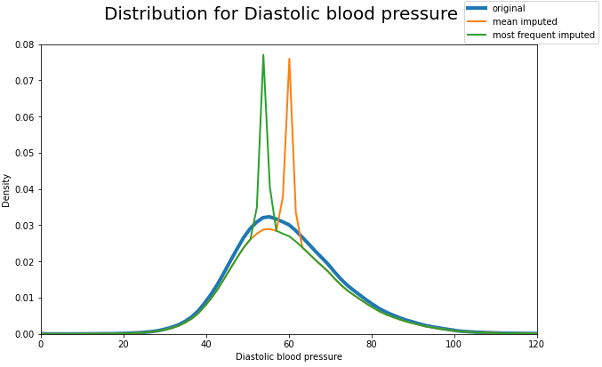
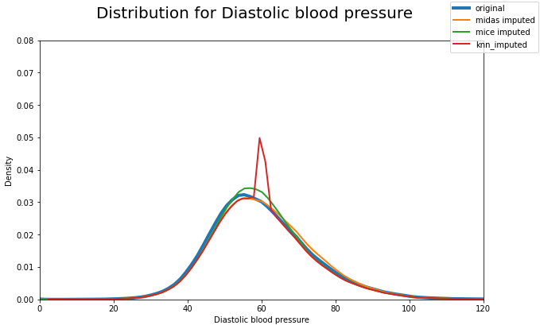
Probabilistic Distribution
Notes:
By plotting the data distribution all datasets, we could visualise how the imputed data is distributed compared to the original data. We see from the graph on the right that MICE and MIDAS imputed has a smooth gaussian distribution that close remembles the distribution of the original data before imputation.
On the other hand for KNN, mean, and most frequent imputed datasets, we see huge spikes in the distribution, which is probably due to the repeated values created during imputation.

Slide 16
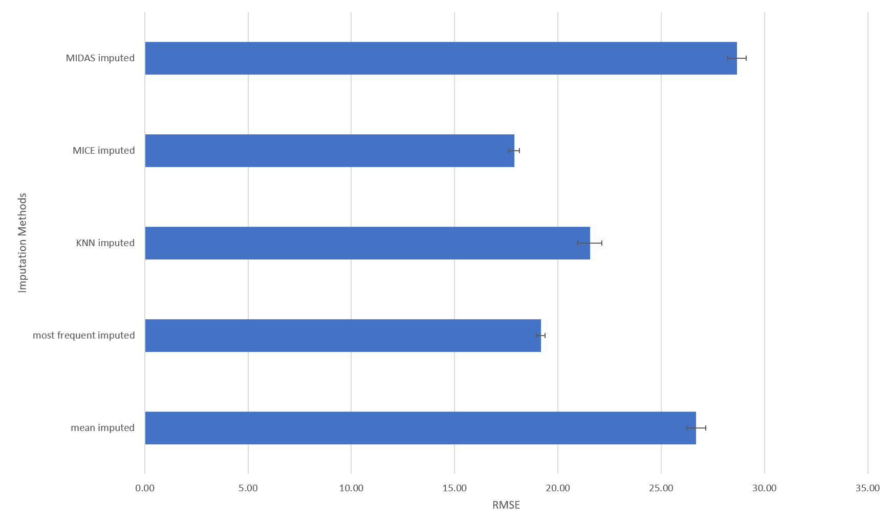
ROOT MEAN SQUARED ERROR FROM LOOCV data simulation
Notes:
The Leave one out data simulation involves introducing additional missingness before imputation then comparing the imputed and original value using cross validation.
Looking at the RMSE for the leave one of cross validation experiment, we see that MICE imputed has the lowest root meet squared error. Showing that MICE imputation method has the best ability to impute data that closely resembles the original data from 2 different experiments.

Slide 17
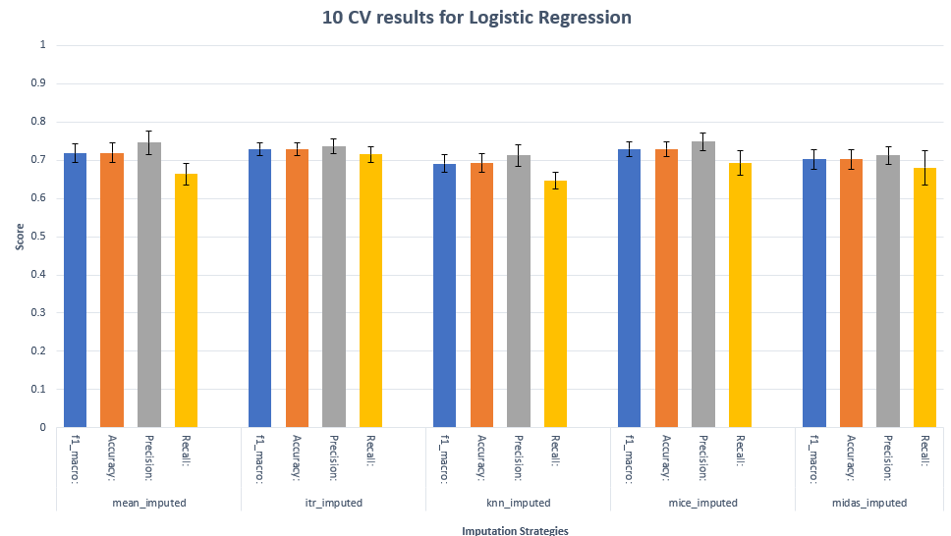
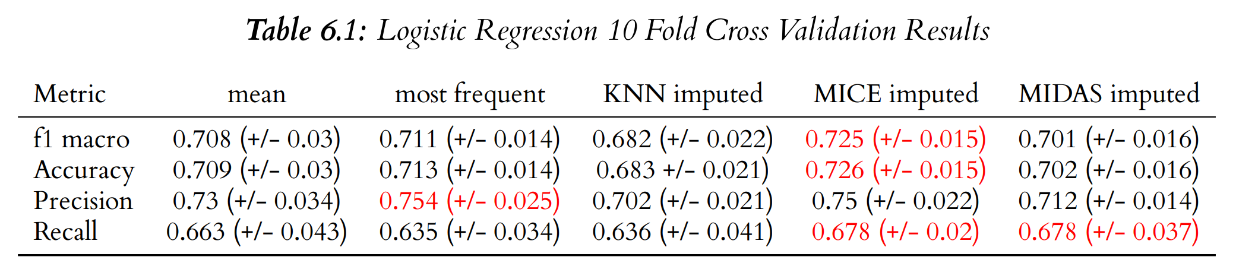
Logistic Regression summary
Notes:
Looking at the logistic regression results, we see that MICE imputation has the highest performance compared to the other methods, however, after applying hypothesis testing techniques, we could not conclude that difference in results was statistically significant.

Slide 18
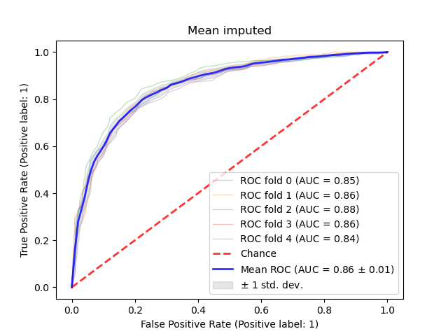
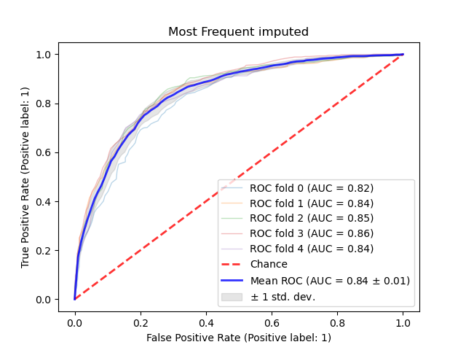
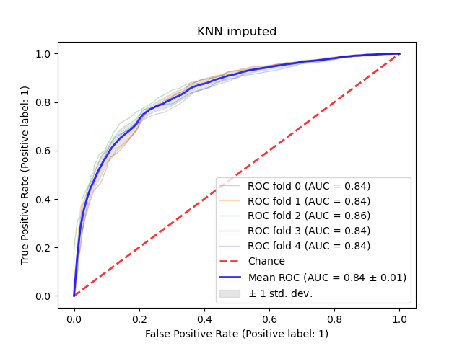
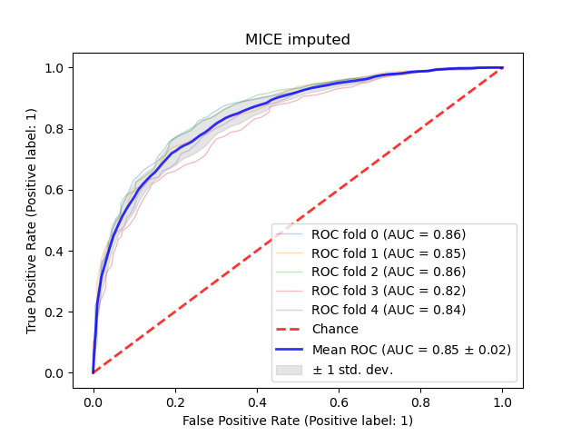
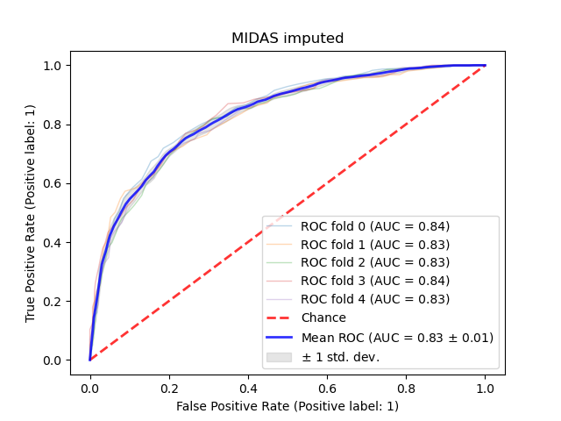
Random Forest (ROC Curve)
Notes:
Looking at the ROC curves and AUC scores for random forest, we can further see how similar these models perform and further strengthen that the difference in performance was not statistically significant. However, one import note is that since mean and most frequent imputation introduced a lot of biased to the dataset, it would will cause the model to overfit and have an illusion of higher performance.

Slide 19
Conclusion
MICE is the most all rounded imputation method for clinical data
Deep learning imputation approaches is still in early stages and not very stable
Uni-variate imputation strategies is not suitable as imputation strategies for medical researches.
Notes:
Considering all evaluation techniques, we can say that MICE is the most all rounded imputation strategy and the most suitable for clinical data use. Although Deep learning imputation strategies has the potential to be the prefered method in the future, it is still in an early phase and not very trusted. Finally, Uni-variate imputation strategies is not suitable as imputation strategies for medical researches.

Slide 20
End of presentation!

Slide 21
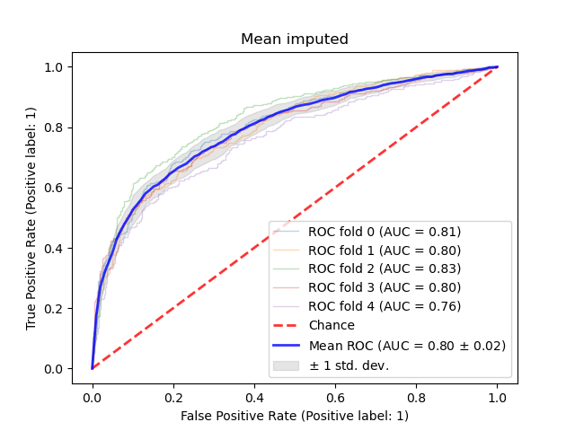
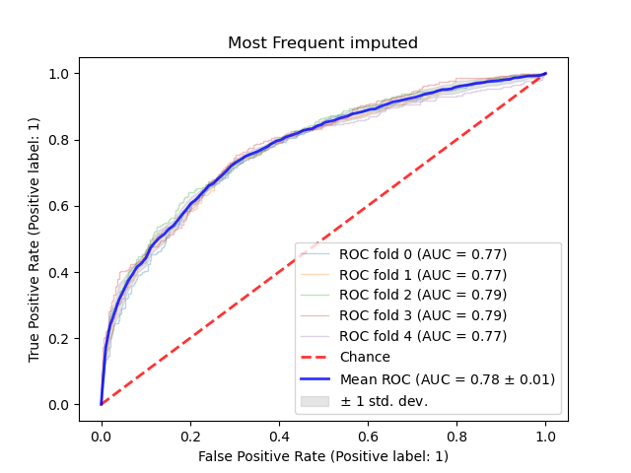
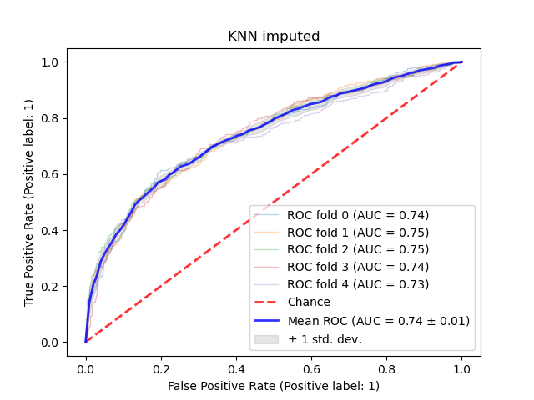
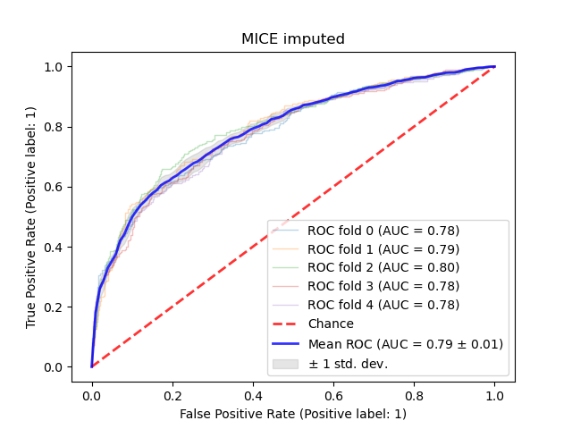
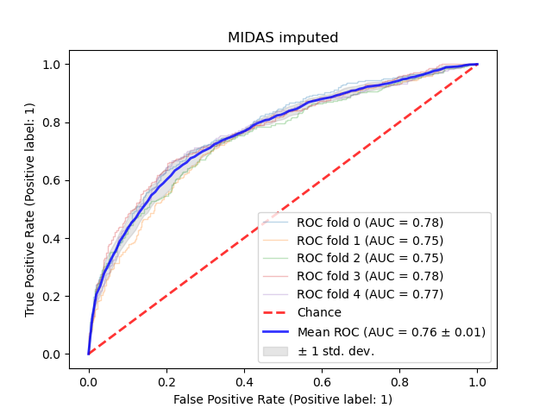
Logistic regression (ROC Curve)

Slide 22
Conclusion

Slide 23
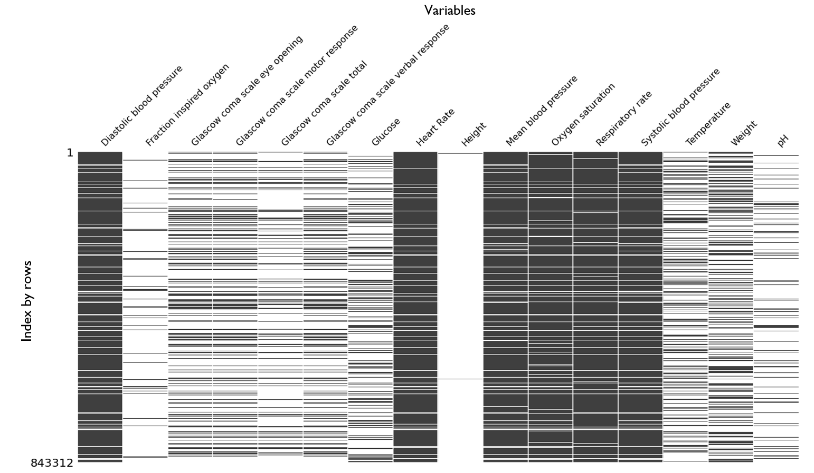
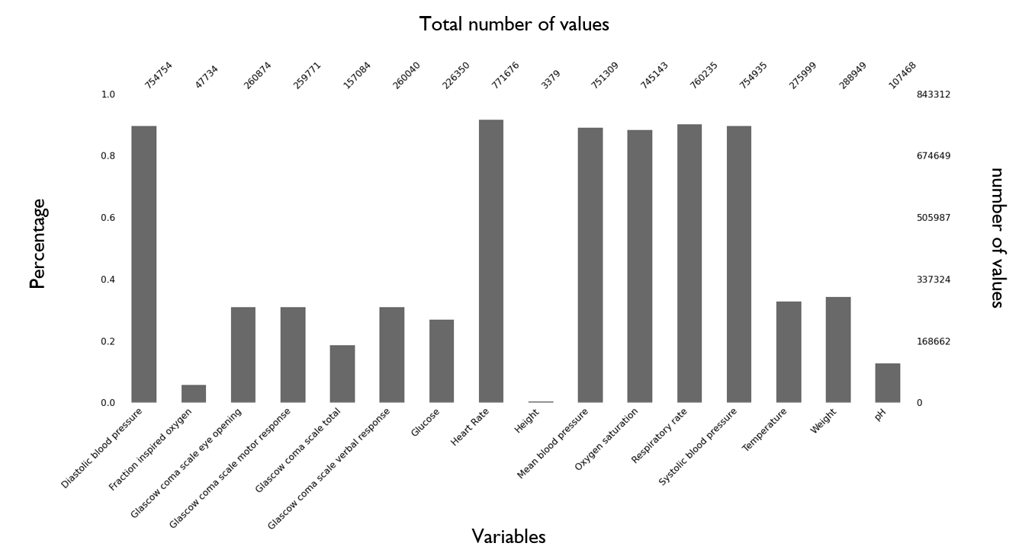
Missingness of the data
Bar Plot
Matrix plot

Slide 24
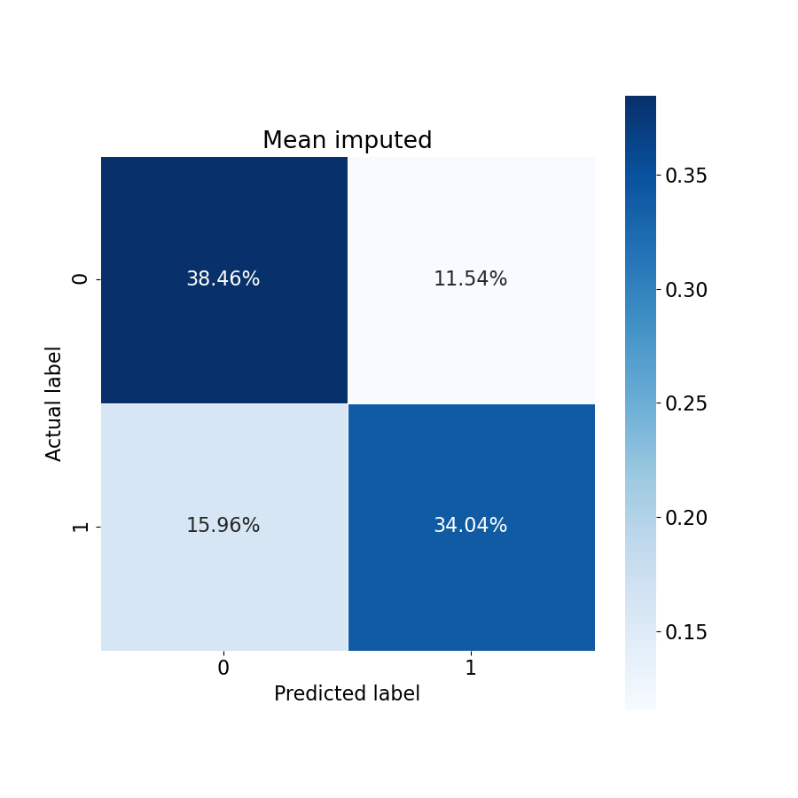
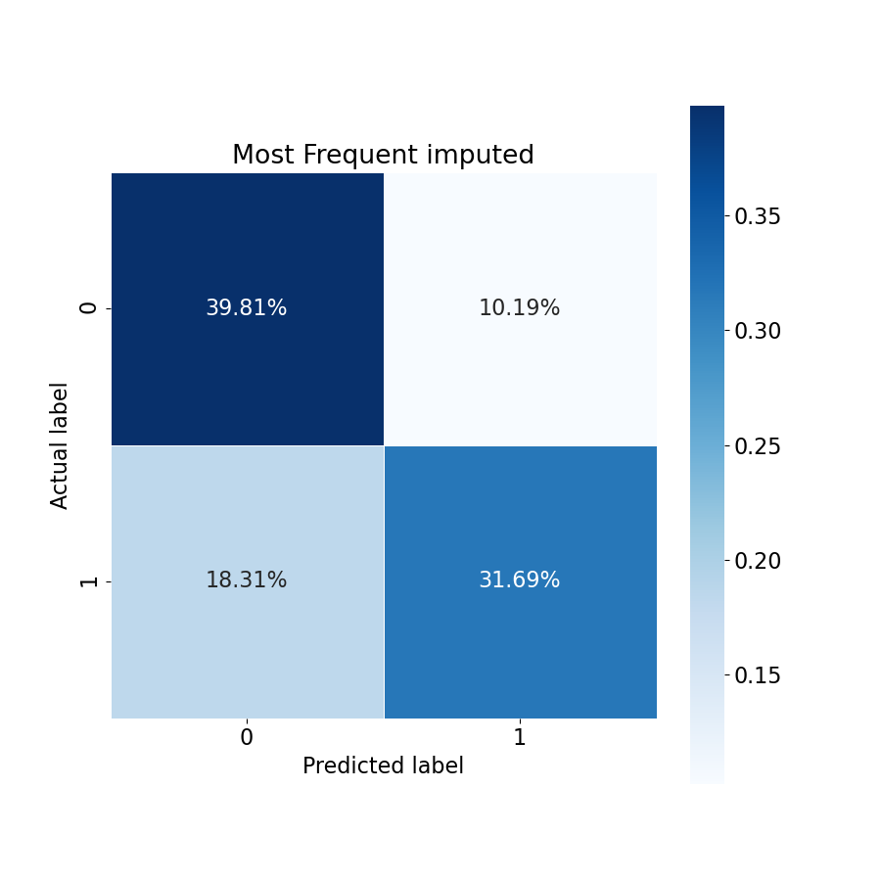



Logistic Regression (Confusion matrix)

Slide 25
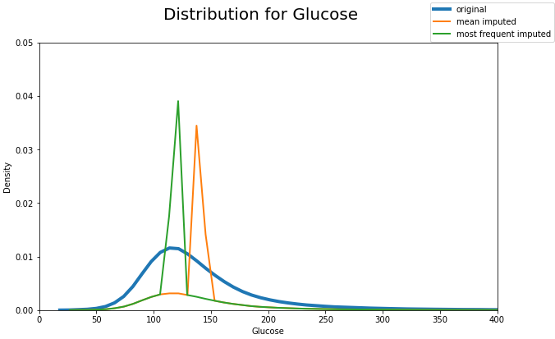
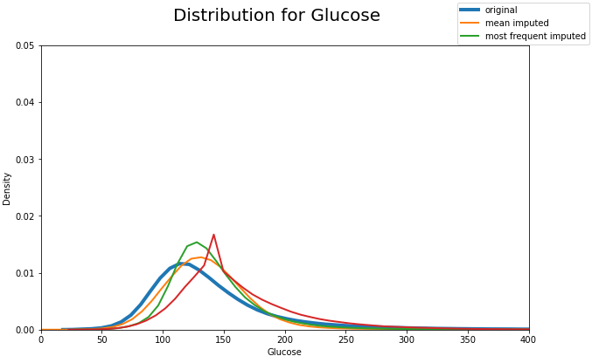
Probabilistic Distribution

Slide 26
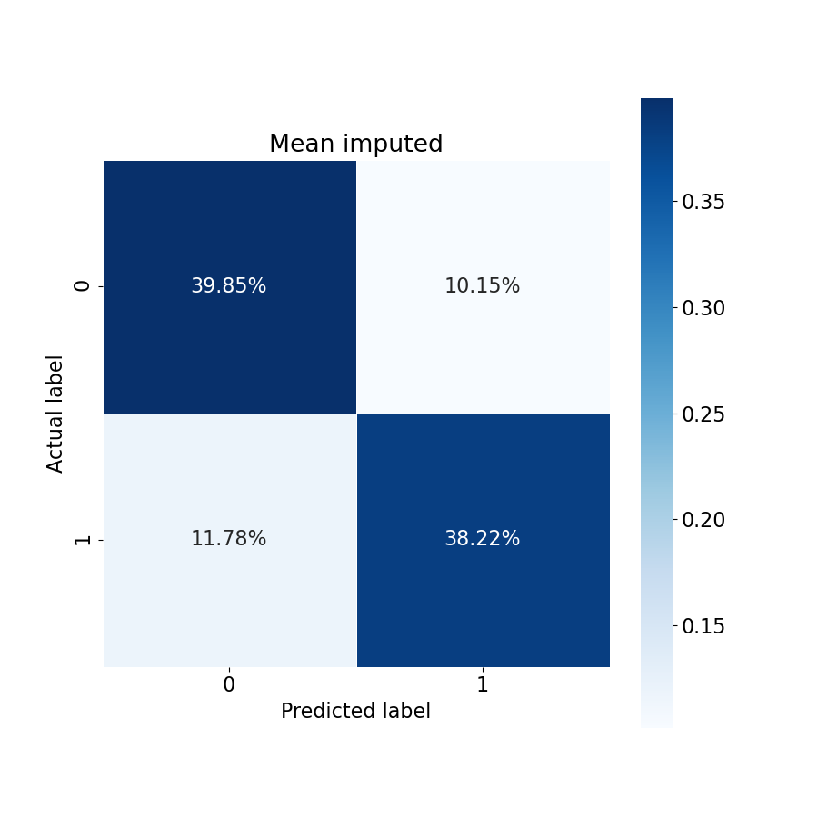
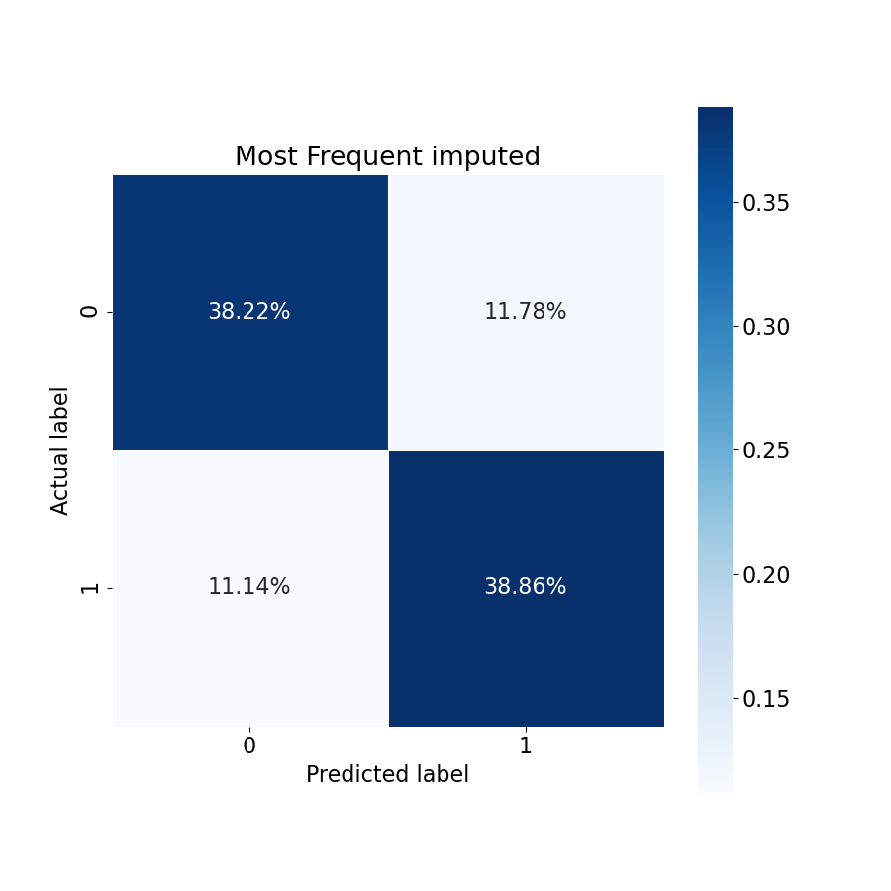
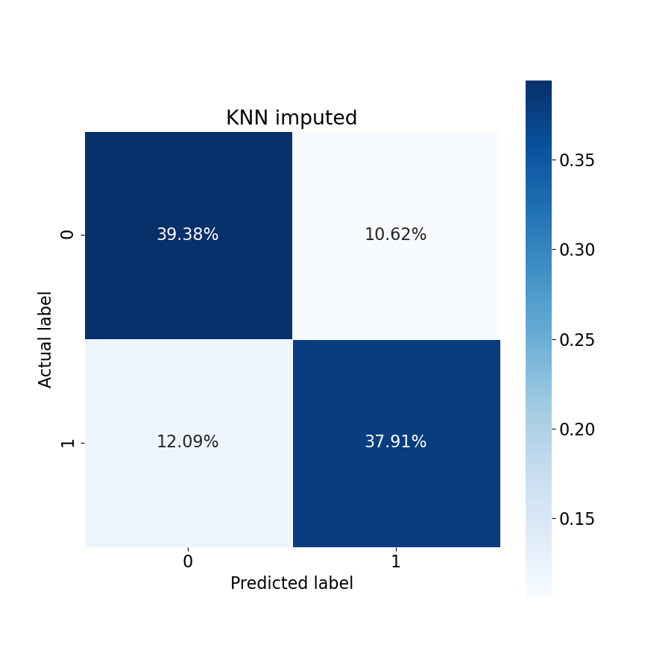

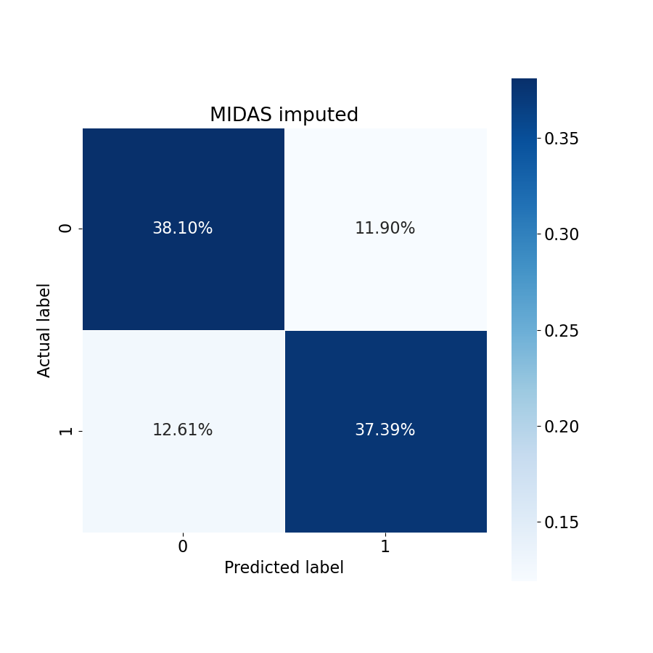
Random Forest (Confusion matrix)

Slide 27





Support Vector Classification (Confusion matrix)

Slide 28
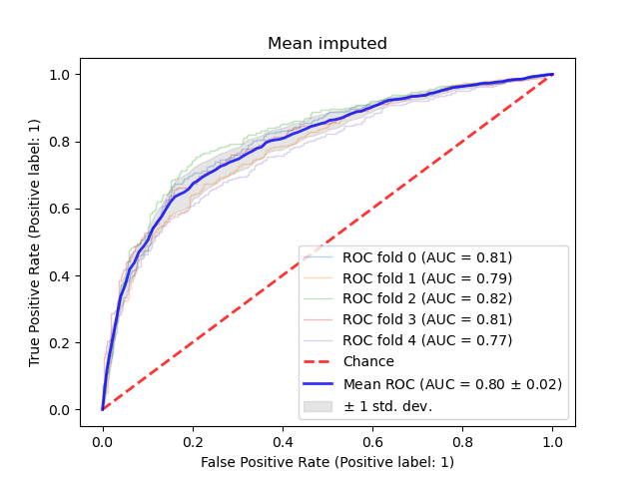
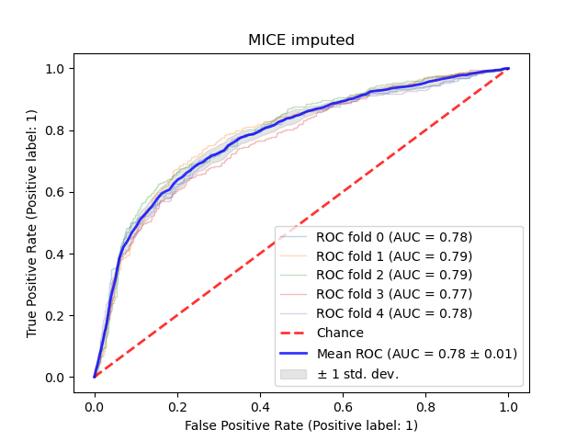
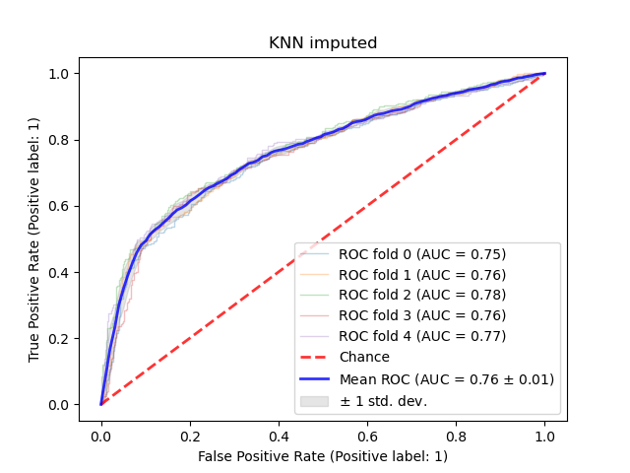
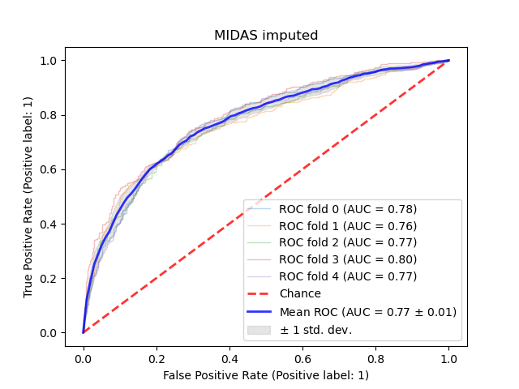
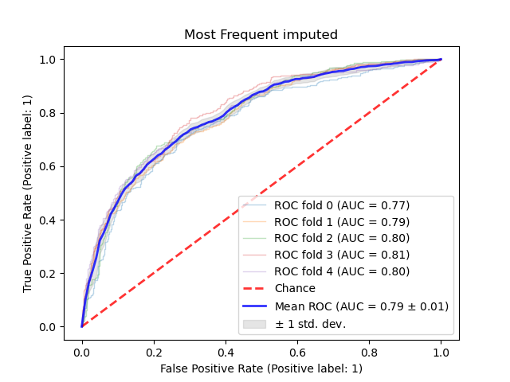
Support Vector Classification (ROC Curve)

Slide 29
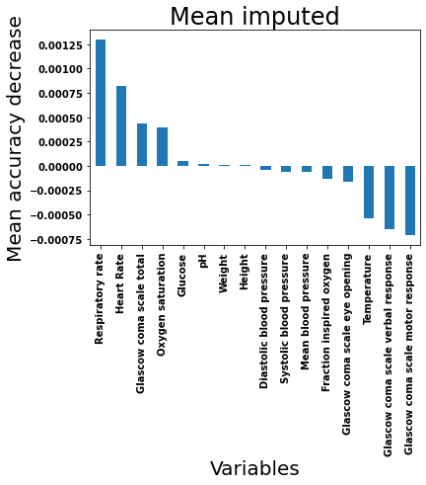
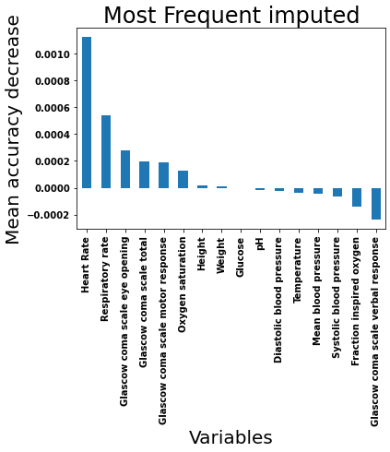
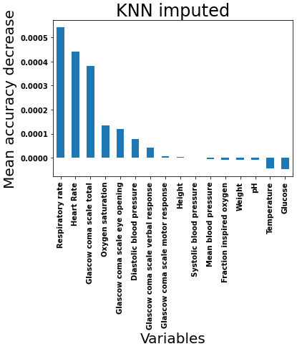
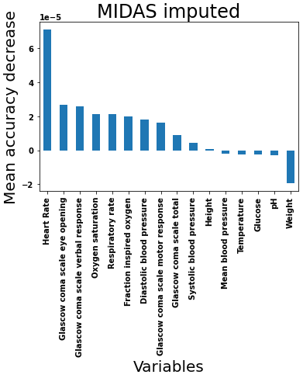
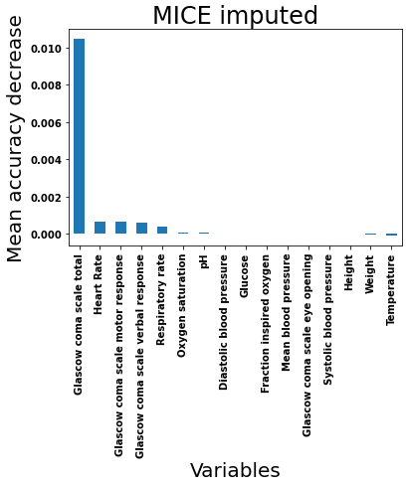
Feature importance

Slide 30
Missingness of data
Missing at random (MAR)
Missing not at random (MNAR)
Missing completely at random (MCAR)

Slide 32
Risk prediction models on Electronic Health records
Electronic health records are heterogeneous
In hospital Mortality as a clinical outcome
Classification Models
Logistic Regression
Random Forest
Support Vector Machines
Notes:
A risk prediction model uses patient data to estimate the probability of a patient experiencing a healthcare outcome. The adoption of clinical risk prediction tools was great limited previously by lack of integration with electronic health records suggested by previous researches. Other researches also mentioned the rigorous process of this task in nature, where problems such as incomplete training data and risk of bias fails to address clinical need. However, With the recent releases of publicly available clinical database, and advancement in both machine learning and imputation strategies, more accurate and reliable risk prediction models are now possible.
Since electronic health records are heterogeneous with all sorts of medical recordings, these recordings must be extracted carefully and reorganised for machine learning. Recent researches suggest the approach to arrange individual measurements in a time series manner. By arranging the medical data by rows of time series, the machine learning model is able to learn complex temporal patterns from the data and improve performance. However, by organizing these recordings in a time series manner, in introduces a lot of missing data since there could not be a record of every variable for every hour.

Slide 33
In hospital-mortality prediction

